Slide 1


AI-Based Role & Access Governance Manager
Revolutionizing Cloud Security with AI-Driven IAM Optimization
by Anudeep Kadavergu

Slide 2

Problem Statement
1
Excessive Permissions
2
Manual IAM
Time-consuming and error-prone.
Security risks in cloud environments.
3
Lack of Visibility
Risky access patterns.

Slide 3

Our Solution
Automated IAM
Continuous Analysis
Role and permission management.
Permissions across cloud.
Real-time Alerts
Risky access patterns.

Slide 4
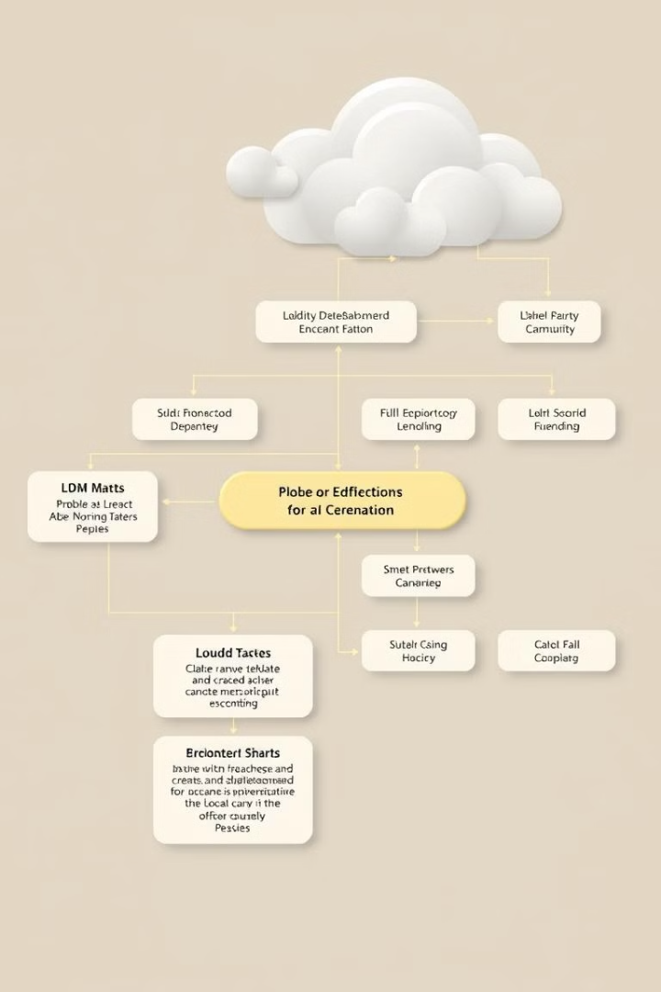


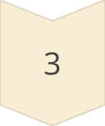

How It Works
Collect Logs
IAM roles and access logs.
Analyze
AI/ML models.
Suggest Access
Least-privilege.
Automate
Permission revocation.

Slide 5




Cost Savings
Reduced Costs
Preventive Security
Compliance
Automated IAM management.
Automated reporting.
Reduces data breach risk.

Slide 6
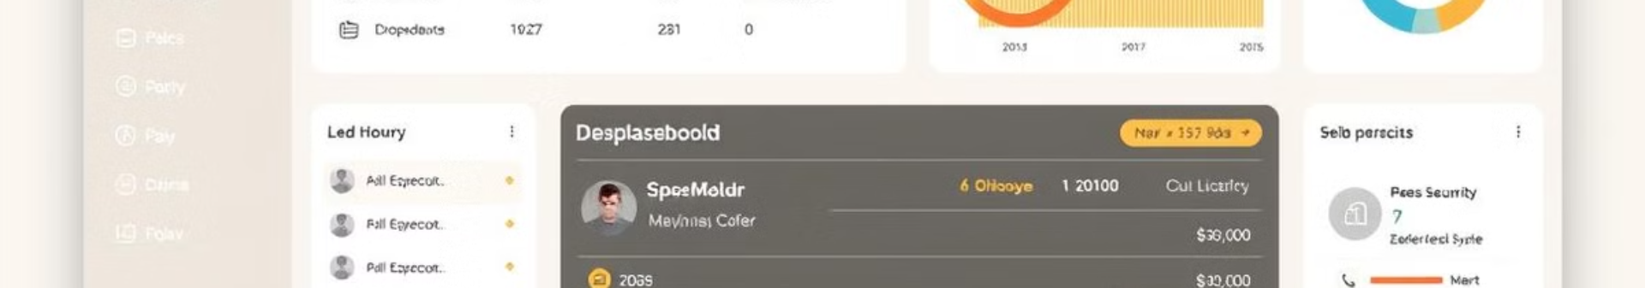
Ease of Use
Intuitive
1
React-based UI.
2
Automation
No manual intervention.
Real-Time
3
Instant notifications.

Slide 7
Innovation
AI-Driven
Continuous
Multi-Cloud
Anomaly detection.
Real-time analysis.
AWS and Azure.

Slide 8
Technical Implementation
Frontend
1
React.js dashboard.
Backend
2
Python Flask API.
AI/ML
3
Scikit-learn, TensorFlow.

Slide 9
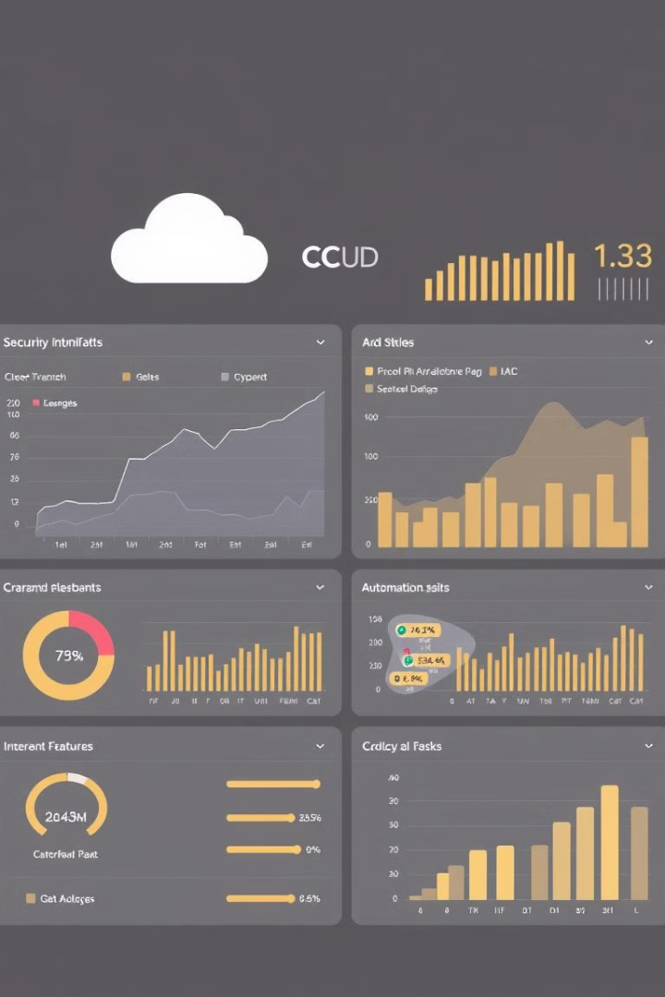
Demo
1
Real-Time
2
User-Friendly
Insights.
Interface.
3
Seamless
Automation.

Slide 10



Benefits
Organizations
2
Reduces costs.
For Admins
1
Saves time.
For Users
3
Minimal disruption.

